Slide 1
Mathematical simulators of a double elastic pendulum and a frozen Argon crystal
First group assignment
Andrea Somma, Giovanni Tomaciello, Paolo Zagardo

Slide 2
Index
Implemented numerical methods
Double elastic pendulum
Frozen Argon Crystal
Lagrangian and Hamiltonian equations

Slide 3

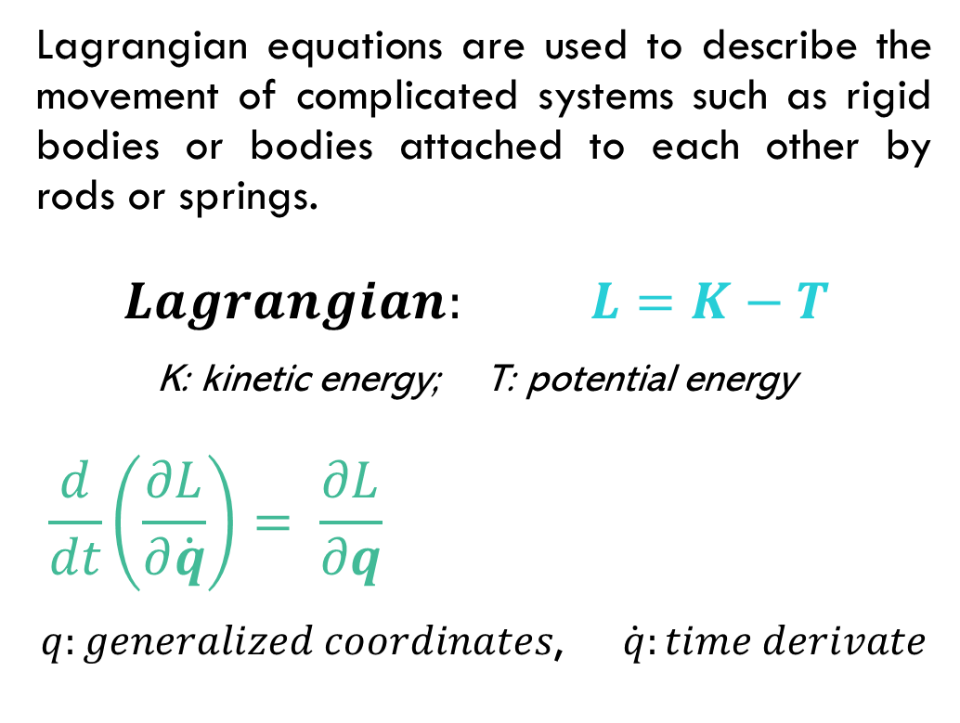
Lagrange’s Equations
Lagrangian equations are used to describe the movement of complicated systems such as rigid bodies or bodies attached to each other by rods or springs.
$$Lagrangian: L=K−T$$
K: kinetic energy; T: potential energy
$$\frac{d}{dt}\left(\frac{∂L}{∂\dot{q}}\right)= \frac{∂L}{∂q}$$
$q:generalized coordinates$, $\dot{q}:time derivate$
Derived
dynamic equations

Slide 4
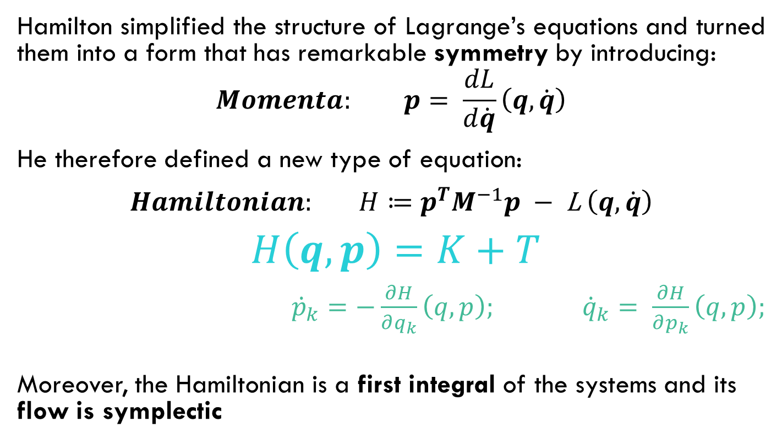
Hamilton’s equations
Hamilton simplified the structure of Lagrange’s equations and turned them into a form that has remarkable symmetry by introducing:
$$Momenta: p= \frac{dL}{d\dot{q}}\left(q,\dot{q}\right)$$
He therefore defined a new type of equation:
$Hamiltonian: H≔p^{T}M^{−1}p −$ L $\left(q,\dot{q}\right)$
$H\left(q,p\right)=K+T$
${\dot{p}}_{k}=−\frac{∂H}{∂q_{k}}\left(q,p\right); {\dot{q}}_{k}= \frac{∂H}{∂p_{k}}\left(q,p\right);$
Moreover, the Hamiltonian is a first integral of the systems and its flow is symplectic
Derived
dynamic equations

Slide 5

Implemented numerical methods
Forward Euler method
Backward Euler method
Velocity Verlet method
Crank–Nicolson method
Symplectic Euler method
Position Verlet method

Slide 6
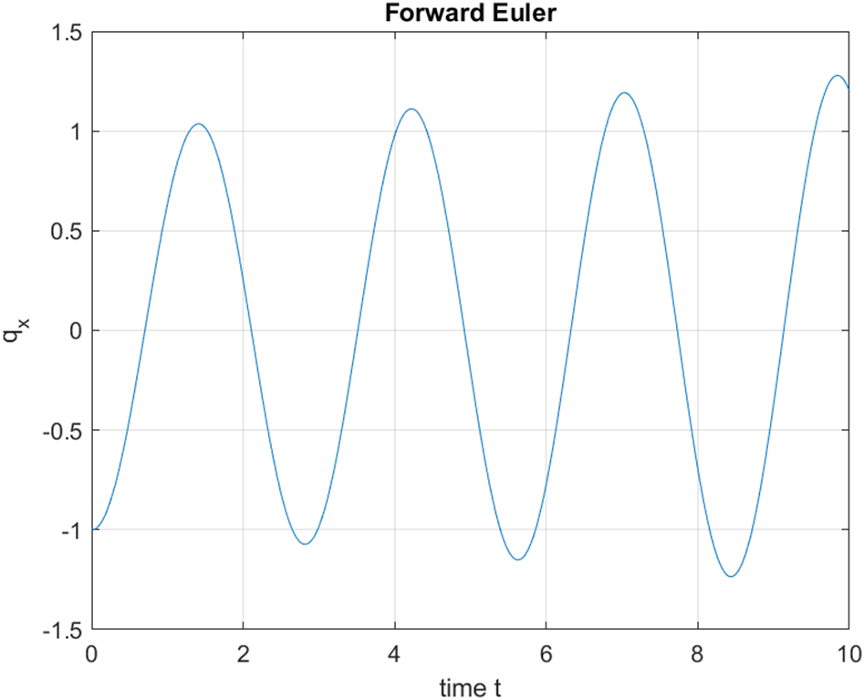
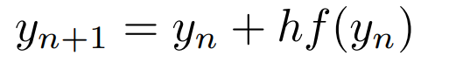
Forward Euler method
Explicit,
1st order,
Instable solution - Amplification,
Not reversible,
Single step.
h: timestep

Slide 7
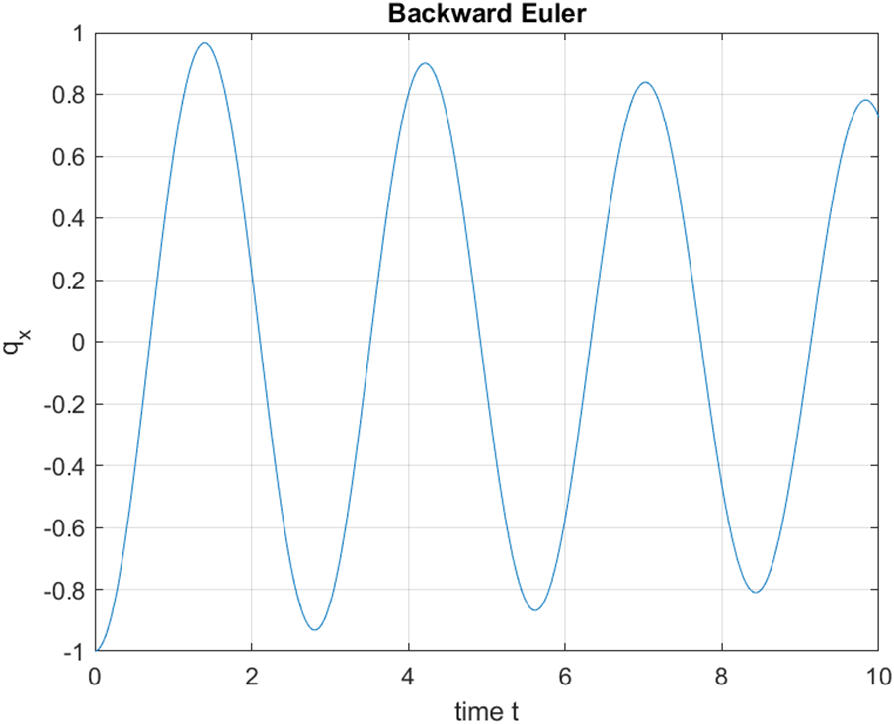
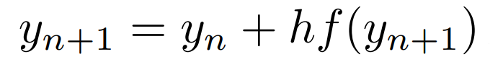
Backward Euler method
Implicit,
1st order,
Stable solution - Damping,
Not reversible,
Single step.

Slide 8
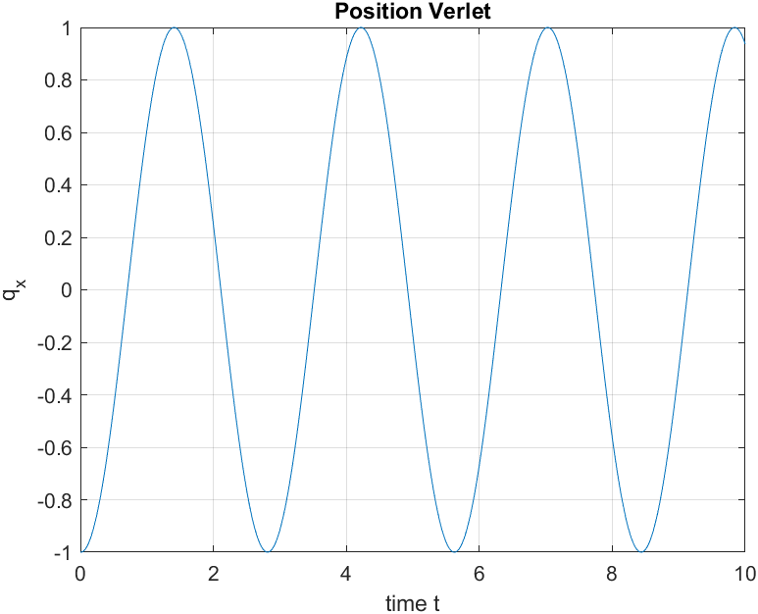
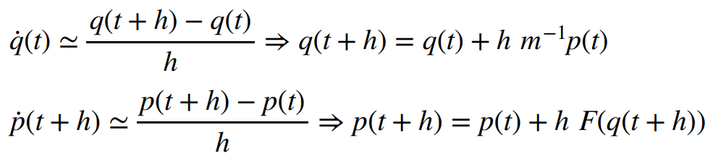
Symplectic Euler Method
Explicit,
1st order,
Symplectic,
Reversible,
Single step.

Slide 9

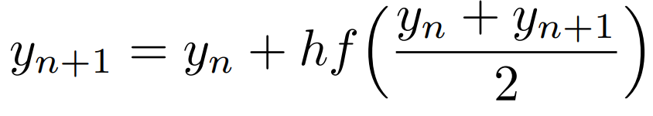
Crank–Nicolson method
Implicit,
2nd order in t, permitting long timesteps,
Stable solution, but out of phase,
Reversible,
Single step.

Slide 10
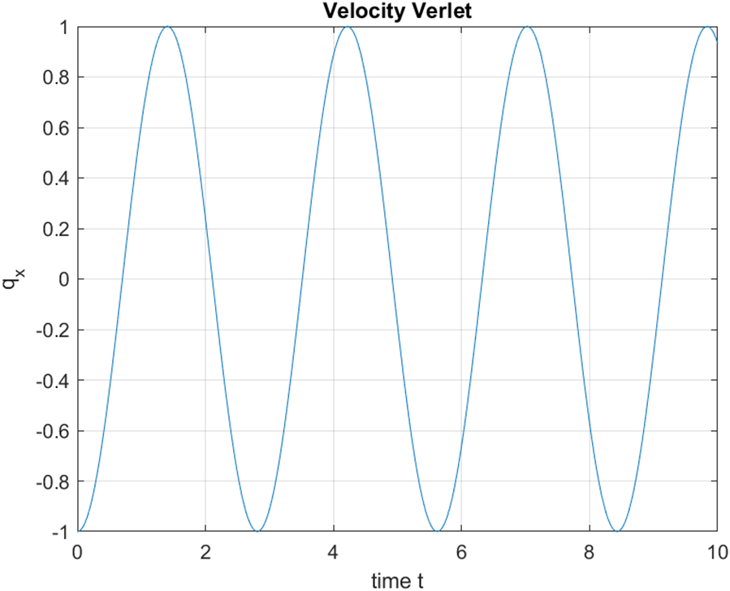
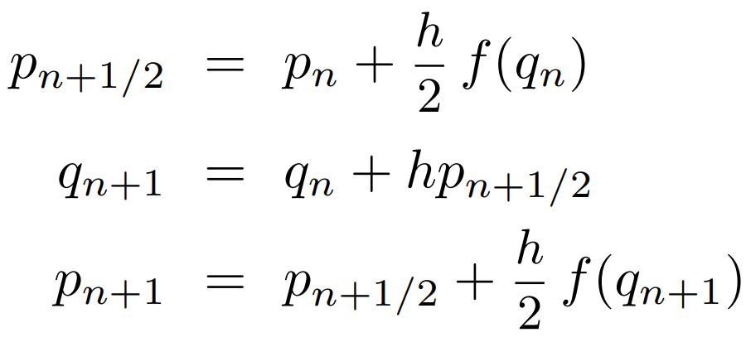
Velocity Verlet method
Explicit,
2nd order in t, permitting long timesteps,
Reversible,
Symplectic,
Single step,

Slide 11

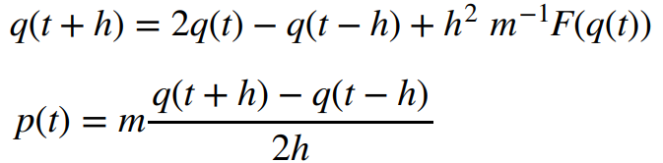
Position Verlet Method
Explicit,
2nd order in t, permitting long timesteps,
Reversible,
Symplectic,
Multi step.
Geometric Numerical Integration Structure-Preserving Algorithms for Ordinary Differential Equations, 2nd edition, pag. 7-8

Slide 12

Double elastic pendulum

Slide 13
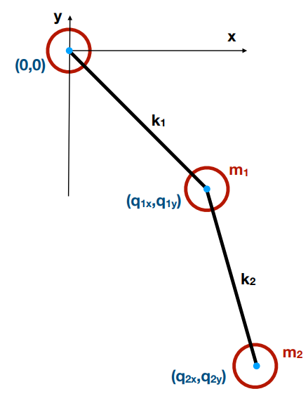
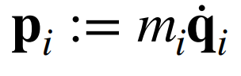
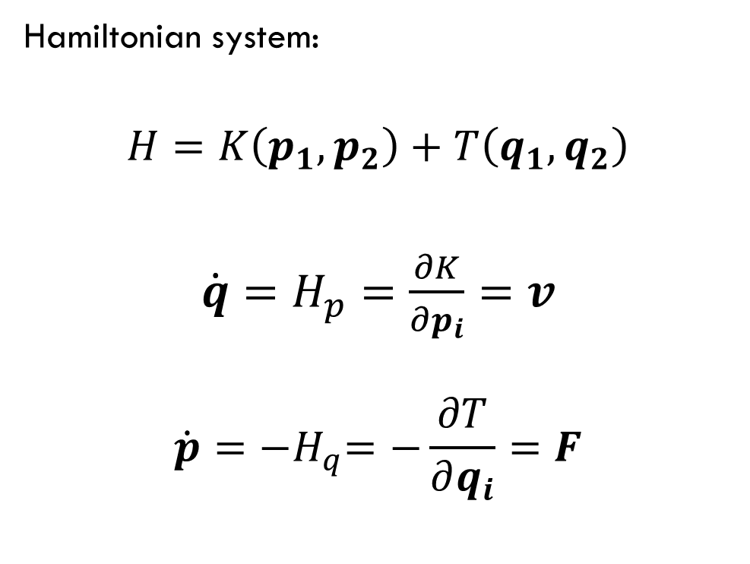
Mathematical model
Hamiltonian system:
$$H=K\left(p_{1},p_{2}\right)+T\left(q_{1},q_{2}\right)$$
$\dot{q}=H_{p}=\frac{∂K}{∂p_{i}}=v$
$$\dot{p}={−H}_{q}=−\frac{∂T}{∂q_{i}}=F$$

Slide 14
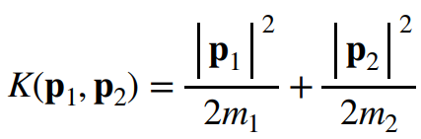
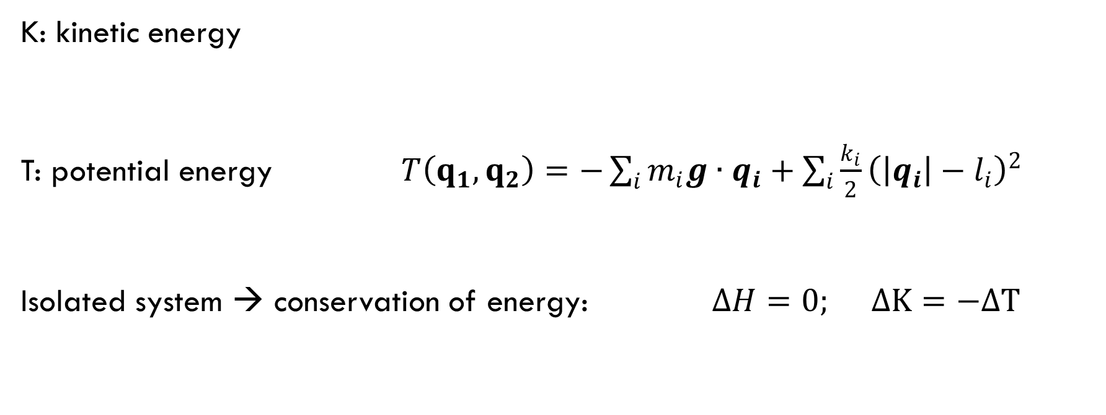
Mathematical model
K: kinetic energy
T: potential energy $T\left(q_{1},q_{2}\right)=−\sum_{i}{m_{i}g∙q_{i}+\sum_{i}{\frac{k_{i}}{2}{\left(\left|q_{i}\right|−l_{i}\right)}^{2}} }$
Isolated system → conservation of energy: $∆H=0; ∆K=−∆T$

Slide 15
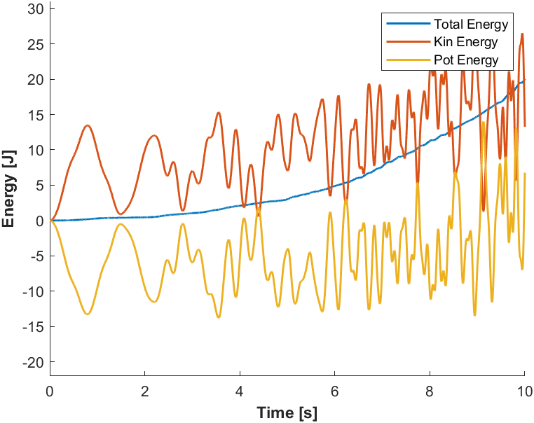
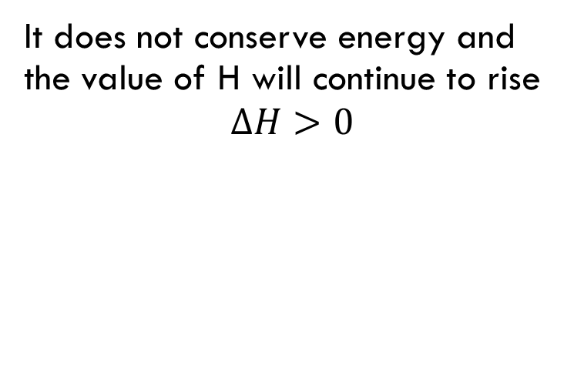
Forward Euler method
It does not conserve energy and the value of H will continue to rise
$$∆H>0$$

Slide 16
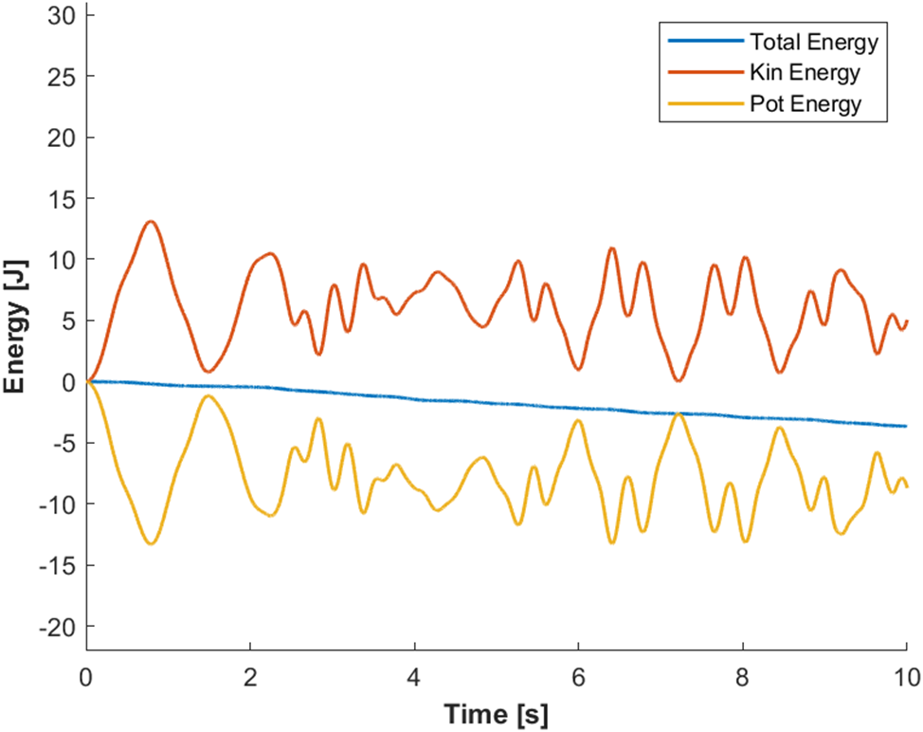
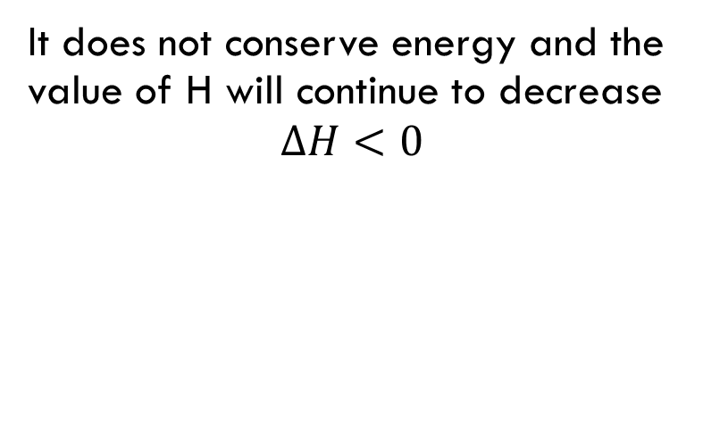
Backward Euler method
It does not conserve energy and the value of H will continue to decrease
$$∆H<0$$

Slide 17
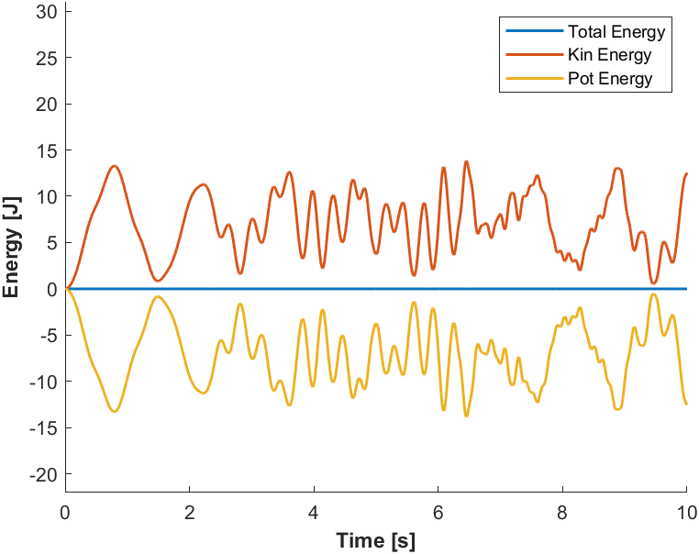
Symplectic Euler Method
It does not conserve the true energy.
Instead, it conserves a “pseudo-hamiltonian” H‡.

Slide 18
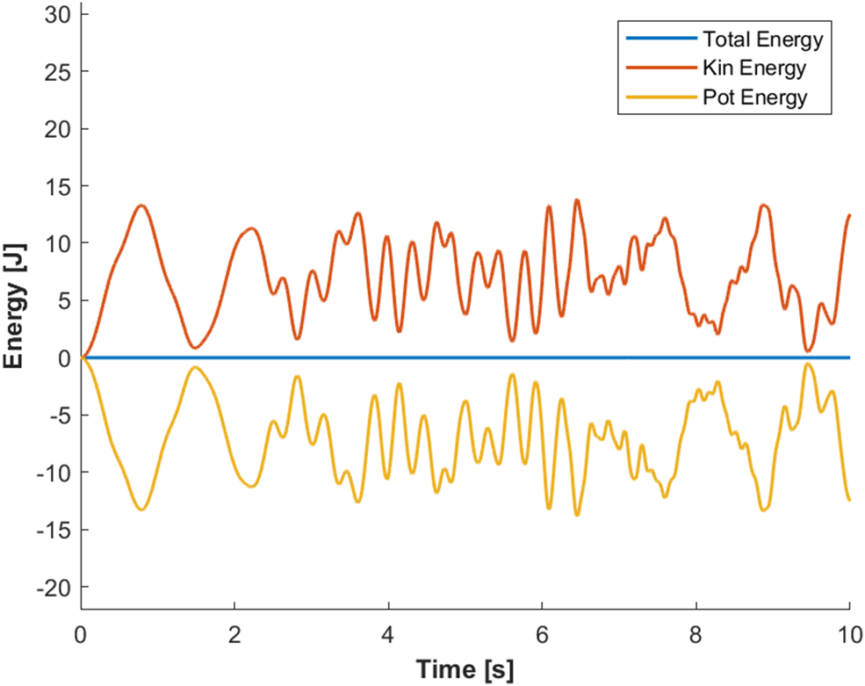
Crank nicolson
Conservation of a “pseudo-hamiltonian” H‡.

Slide 19

Velocity Verlet
Conservation of a “pseudo-hamiltonian” H‡.
H‡ =H + o(h²).

Slide 20

Position Verlet Method
Similar to velocity Verlet: it conserves a “pseudo-hamiltonian” H‡.
H‡ =H + o(h²).

Slide 21
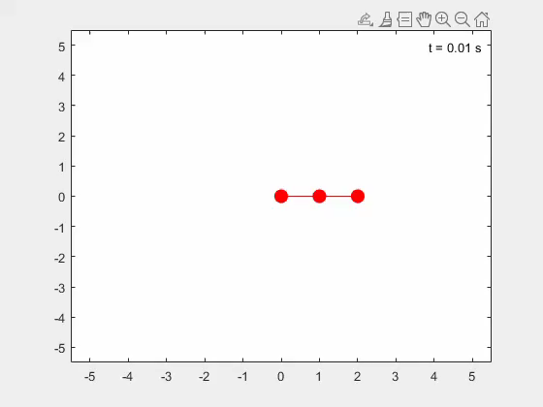
.
q_{y}
m₁ = 1;
m₂ = 0.2;
k₁ = 100;
k₂ = 100;
l₁ = 1;
l₂ = 1;
g_{x} = 0;
g_{y} = -9.81;
m₁
m₂
q1 = (1,0,0)
q2 = (2,0,0)
p1 = (0,0,0)
p2 = (0,0,0)
q_{x}

Slide 22
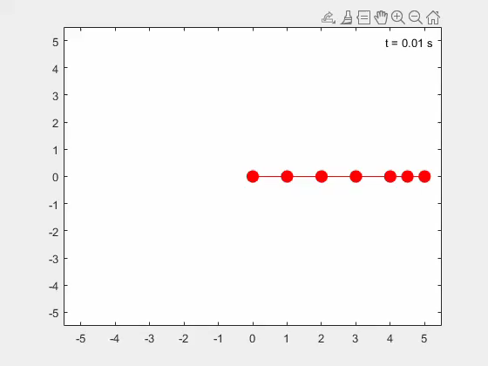
Implementation for n masses
.
m = [1 0.2 0.1 0.05 0.025 0.0125];
l = [1 1 1 1 0.5 0.5];
g = [0 -9.81 0];
k_{i} = 100;
q0 = [1 0; 2 0; 3 0; 4 0; 4.5 0; 5 0];
p0 = [0 0; 0 0; 0 0; 0 0; 0 0; 0 0];
m₁
m₂
m₃
m₄
m₆
m₅

Slide 23
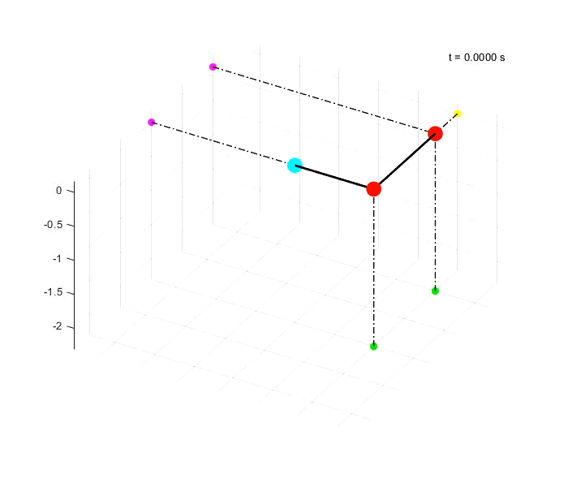
3D Pendulum
m₂
m₁ = 1;
m₂ = 0.2;
k₁ = 100;
k₂ = 100;
l₁ = 1;
l₂ = 1;
g = (0,0,-9,81);
q1 = (1,0,0)
q2 = (1,1,0)
p1 = (0,0,0)
p2 = (0,0,0)
m₁

Slide 24
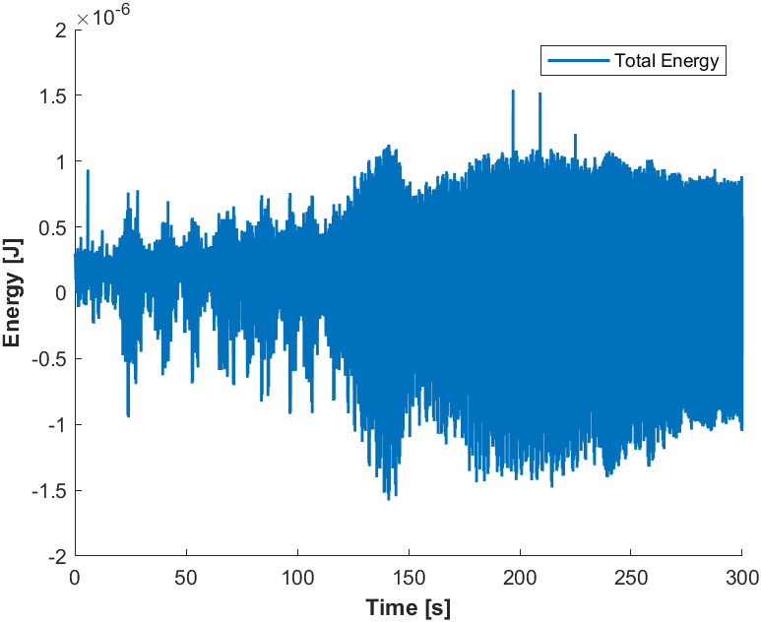
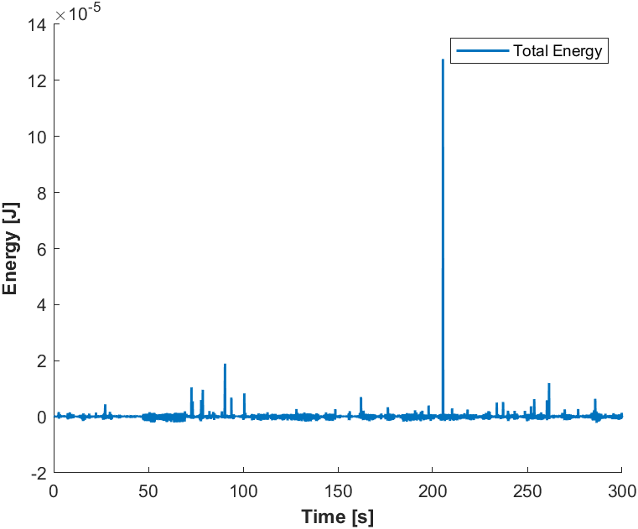
increasing Springs’ stiffness
Position Verlet
k1 = 100
h = 10⁻⁴
k2 = 1
k2 = 10

Slide 25
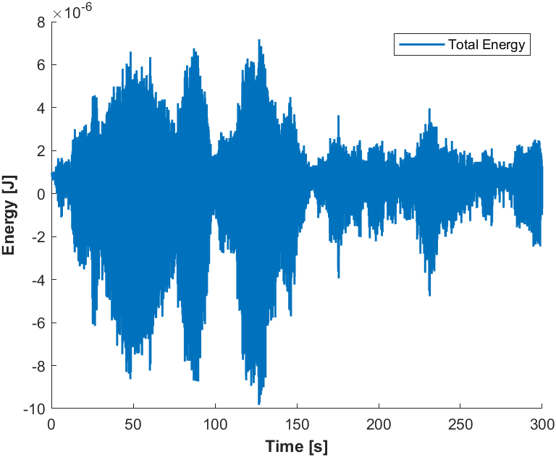
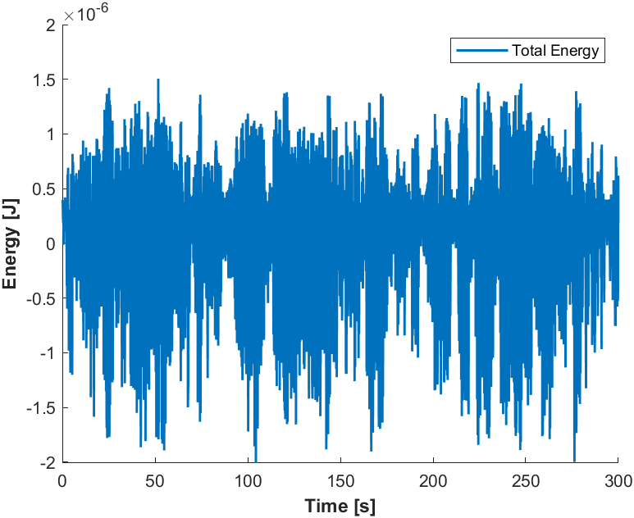
Only varing k2
k2 = 1e2
k2 = 1e3

Slide 26
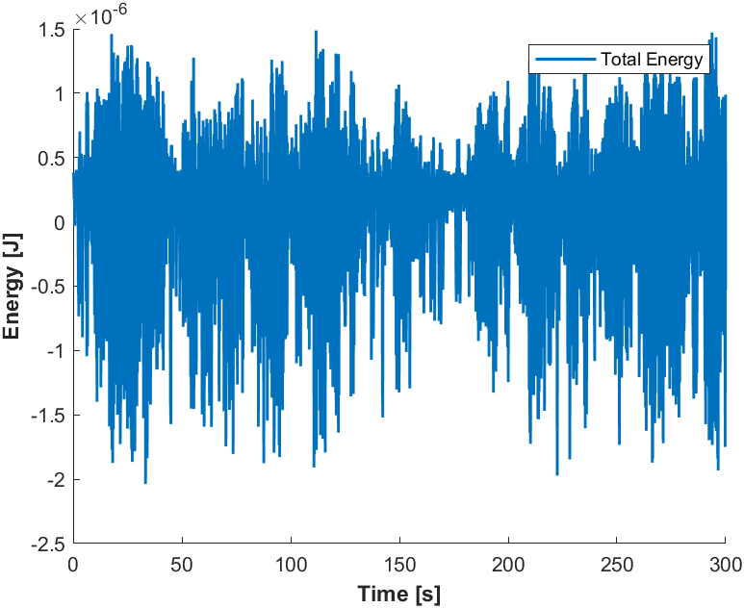
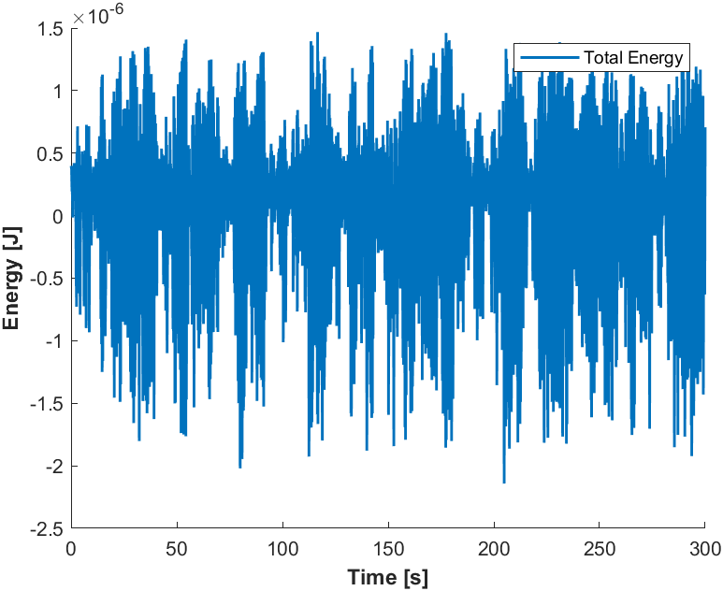
Only varing k2
k2 = 1e4
k2 = 1e5

Slide 27
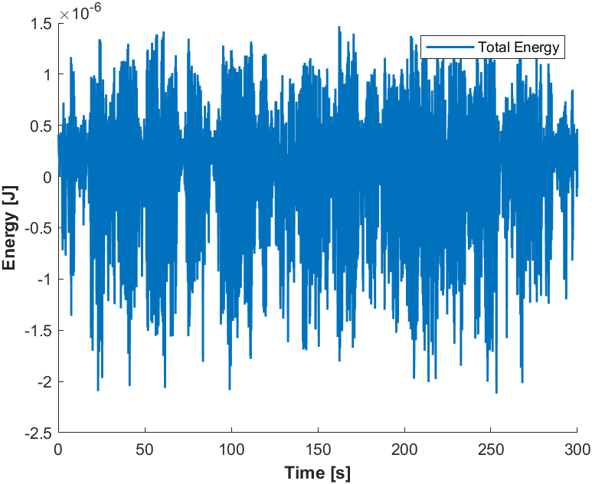
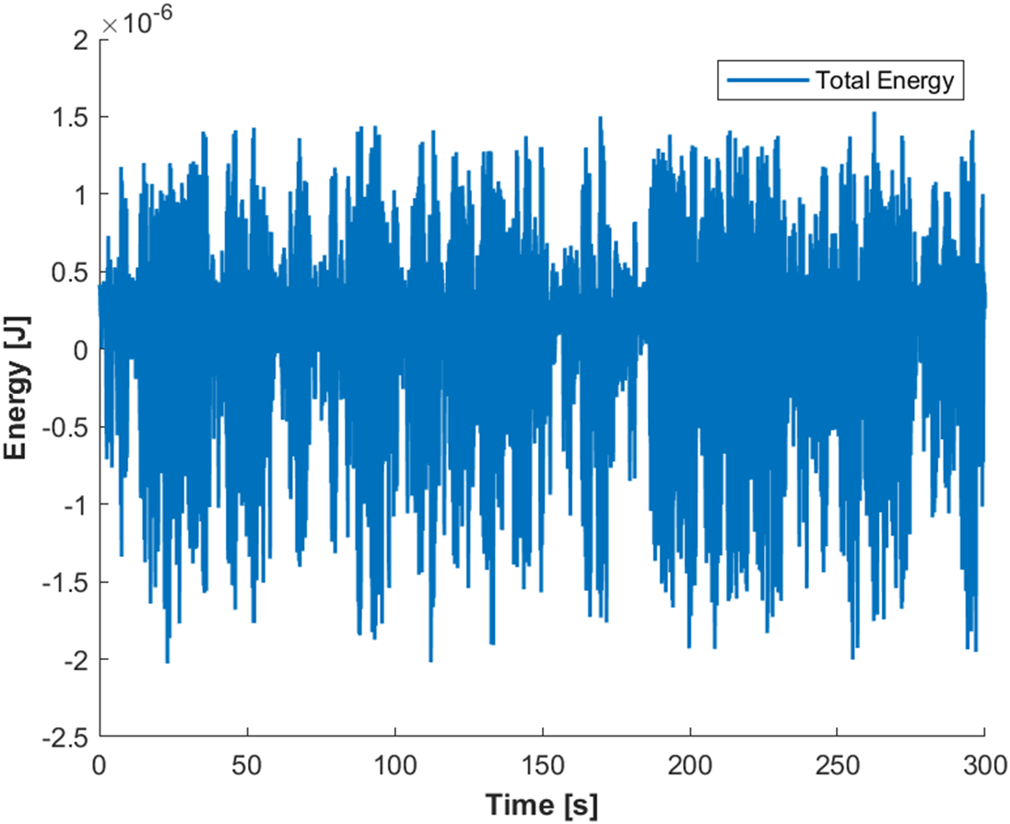
Only varing k2
k2 = 1e6
k2 = 1e7

Slide 28
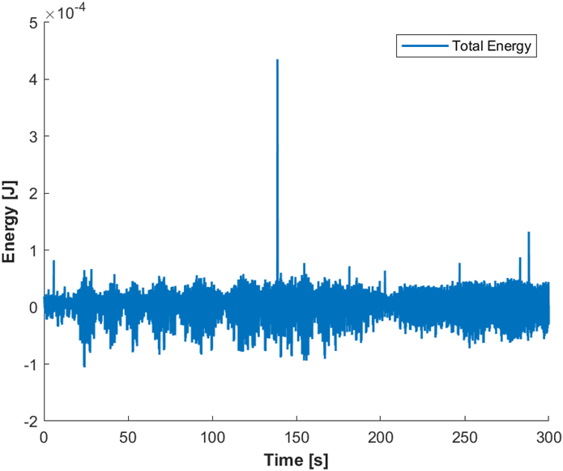
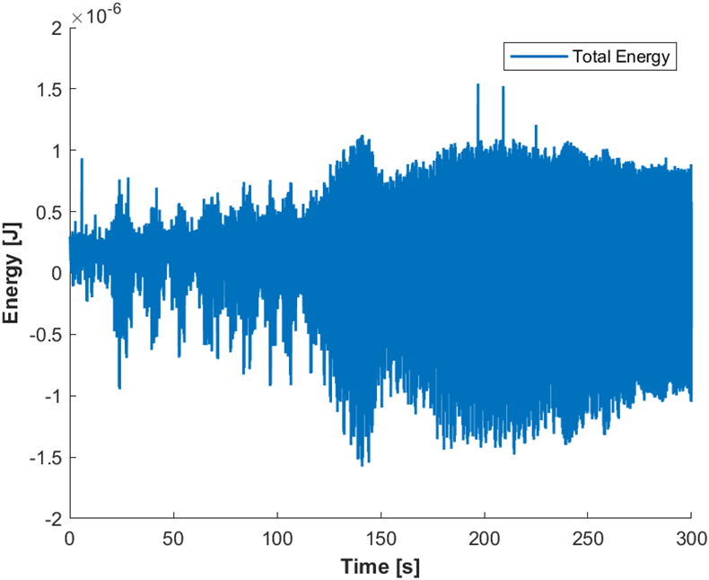
Changing time step: h
Position Verlet;
k1 = 1e2; k2 = 1e0
h=1e-3
h=1e-4

Slide 29
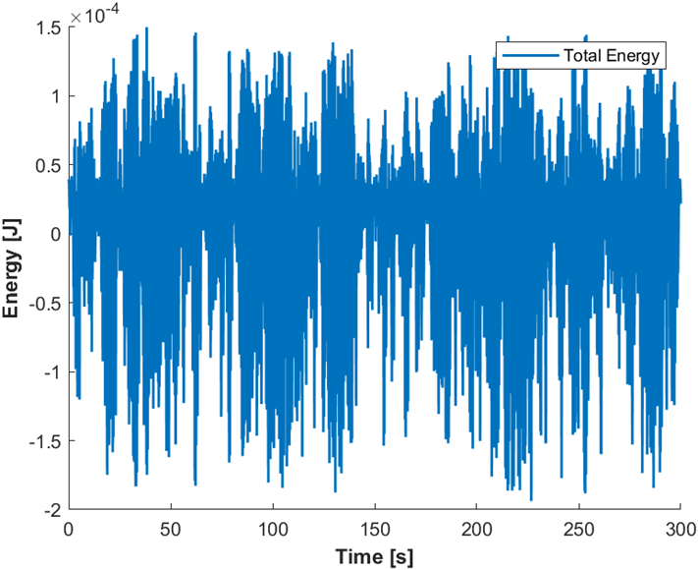

Position Verlet; k1 = 1e2; k2 = 1e3
h=1e-3
h=1e-4

Slide 30
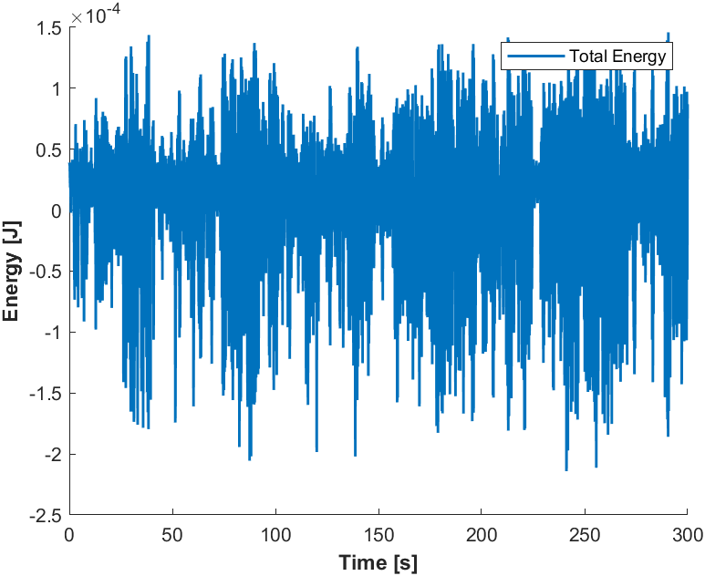

Position Verlet; k1 = 1e2; k2 = 1e5
h=1e-3
h=1e-4

Slide 31
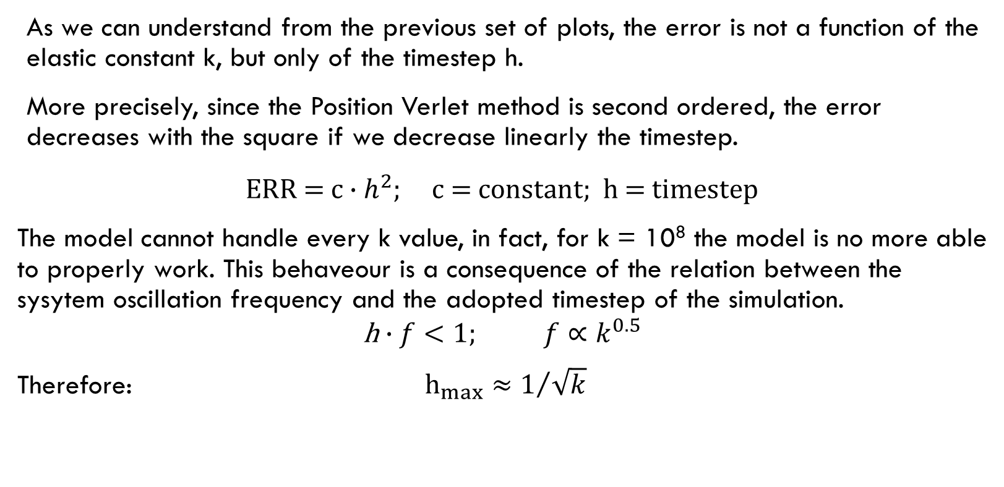
Relation between k and h
As we can understand from the previous set of plots, the error is not a function of the elastic constant k, but only of the timestep h.
More precisely, since the Position Verlet method is second ordered, the error decreases with the square if we decrease linearly the timestep.
$$\text{ERR}\text{ = }\text{c}∙h^{2}\text{; }\text{c}\text{ = }\text{constant}\text{; }\text{h}\text{ = }\text{timestep}$$
The model cannot handle every k value, in fact, for k = 10⁸ the model is no more able to properly work. This behaveour is a consequence of the relation between the sysytem oscillation frequency and the adopted timestep of the simulation.
$$\text{h}∙f<1; f∝k^{0.5}$$
Therefore: $h_{max}≈1/{\sqrt{k}}$

Slide 32
Parte 2…

